Slide 1
Case Based Surveillance System and Integrated Disease Surveillance
Prosper Behumbiize
HISP Uganda

Slide 2
Background and rationale
As demonstrated during the West Africa Ebola Outbreak, lack of a robust suspect case registry linked to lab for confirmation greatly hinders both early detection and rapid response activities
Routine aggregate surveillance data managed centrally is not sufficient for either detection or response demands
CDC GHS Program working with the Ministries of health and key partners in country aim to implement linked data systems for early detection and response

Slide 3
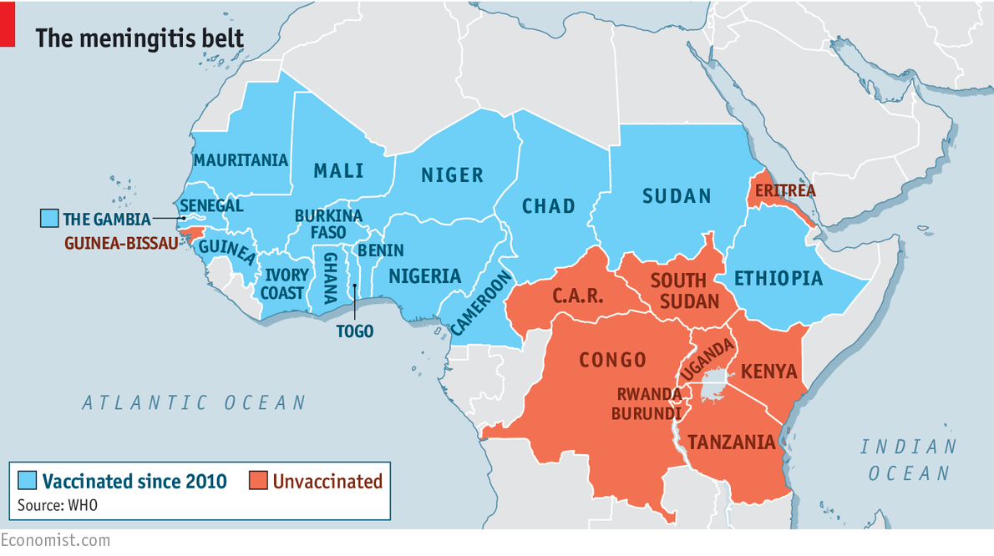
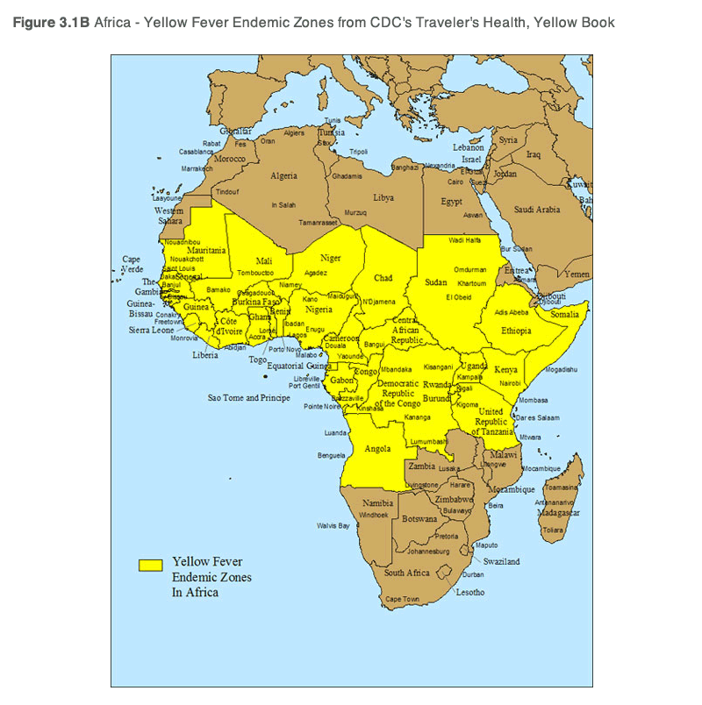
Background: Uganda is vulnerable to Public Health Events
Location near hot spot (emerging zoonoses) - in yellow fever, meningitis belts
Climate change -prone to floods, drought, landslide
Globalization (trade, travel, porous borders)
Prone to outbreaks (viral hemorrhagic fevers, cholera, meningitis, plague, anthrax)

Slide 4
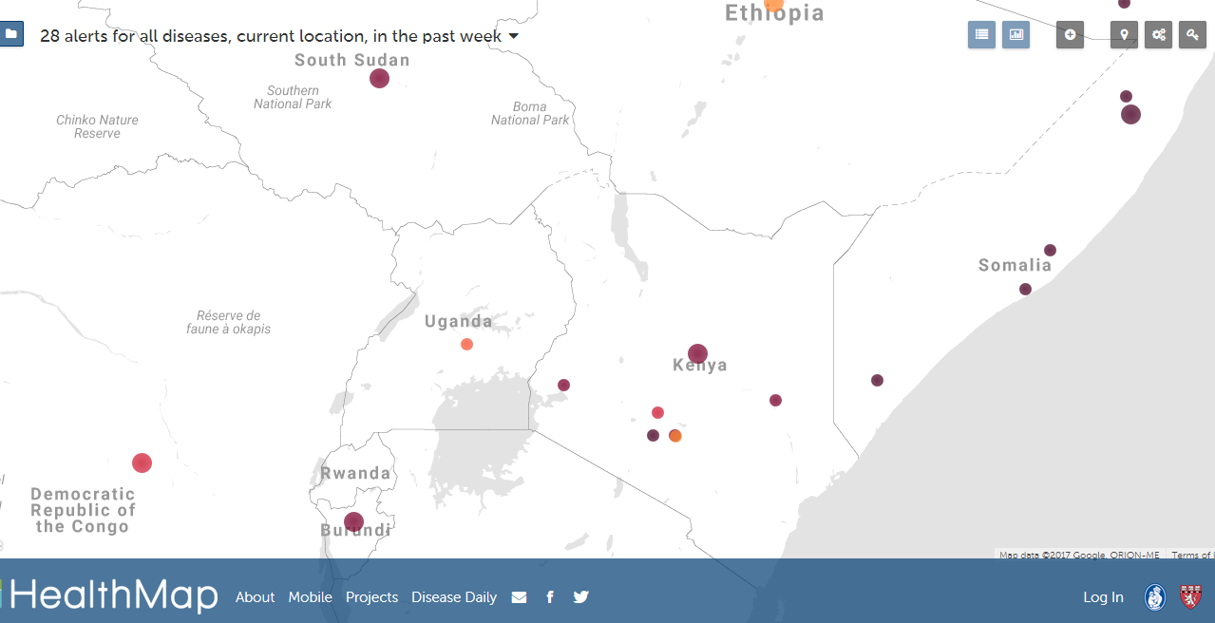
PHEs in and around Uganda

Slide 5
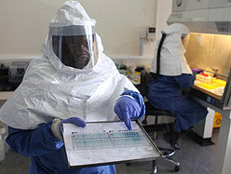
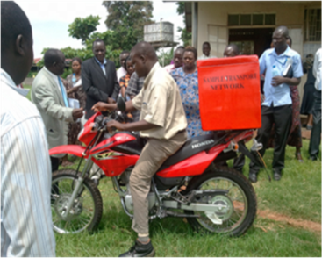
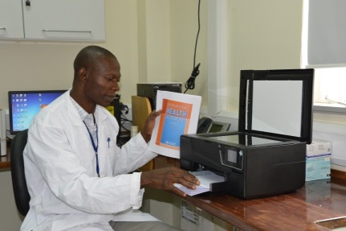
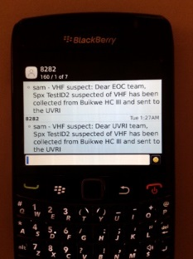
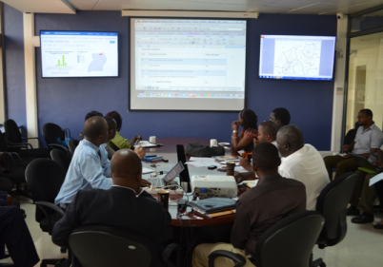
Elements of GHSA in Uganda
Nationwide Lab Network
Real-Time Information System
Prevent
Detect
Respond
Emergency Operations Center
Notes:
key achievements in three areas: 1) communications, 2) specimen transportation and 3) diagnostic capability
National lab network is key to the National Surveillance System – an IDSR priority
Covers sample collection, transport, and analysis
REAL TIME: covers sample transporting and

Slide 6
PHEs Information Sources and Flow
CBS
CBS

Slide 7
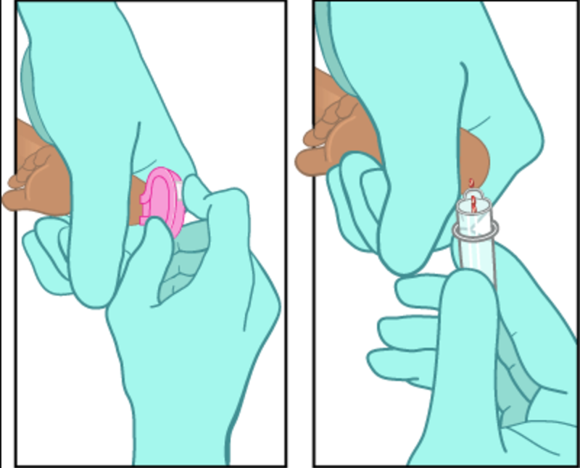
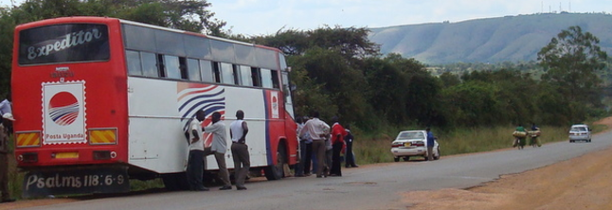
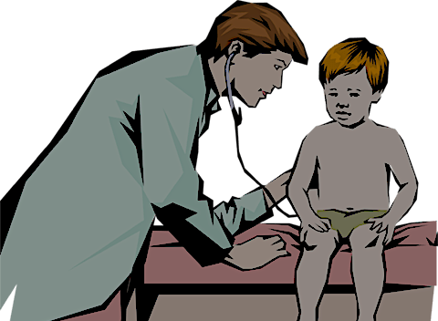
Example from Community
Lab Collects Specimen and Requests for Confirmatory test
Community Reports Case to Health Center
Confirmation Lab receives specimen, tests and provides results
Specimen Transported to the Conformation Lab
Clinical Diagnoses of the Case,
Completes Measles CIF

Slide 8
Case Registration
Lab Results
+Ve Cases >= Threshold
Possible Outbreak

Slide 9
Case Monitoring
Case Registration
Lab Request
Specimen Tracking
Lab Results
+Ve Cases >= Threshold
Contact Tracing
Possible Outbreak

Slide 10
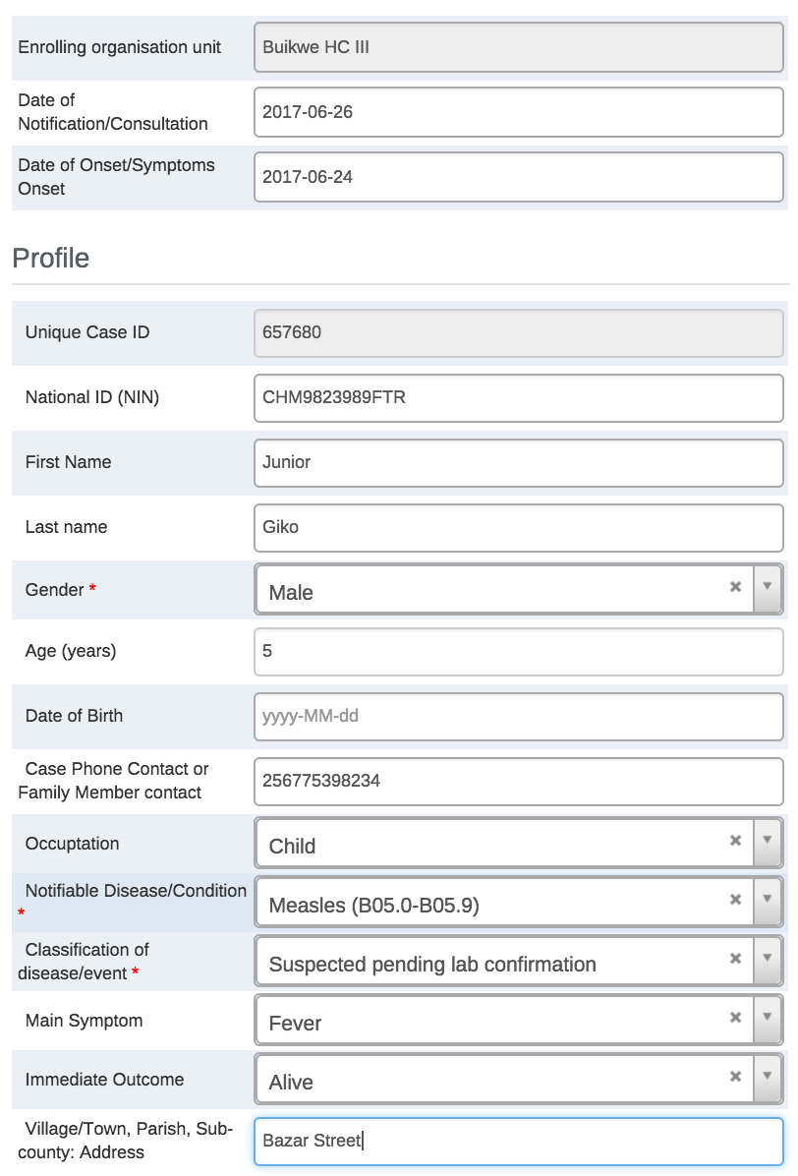
Case Registration
A Measles (B05.0-B05.0) case from Mubaraka Road has been registered at Buikwe HC III and is Suspected pending lab confirmation

Slide 11
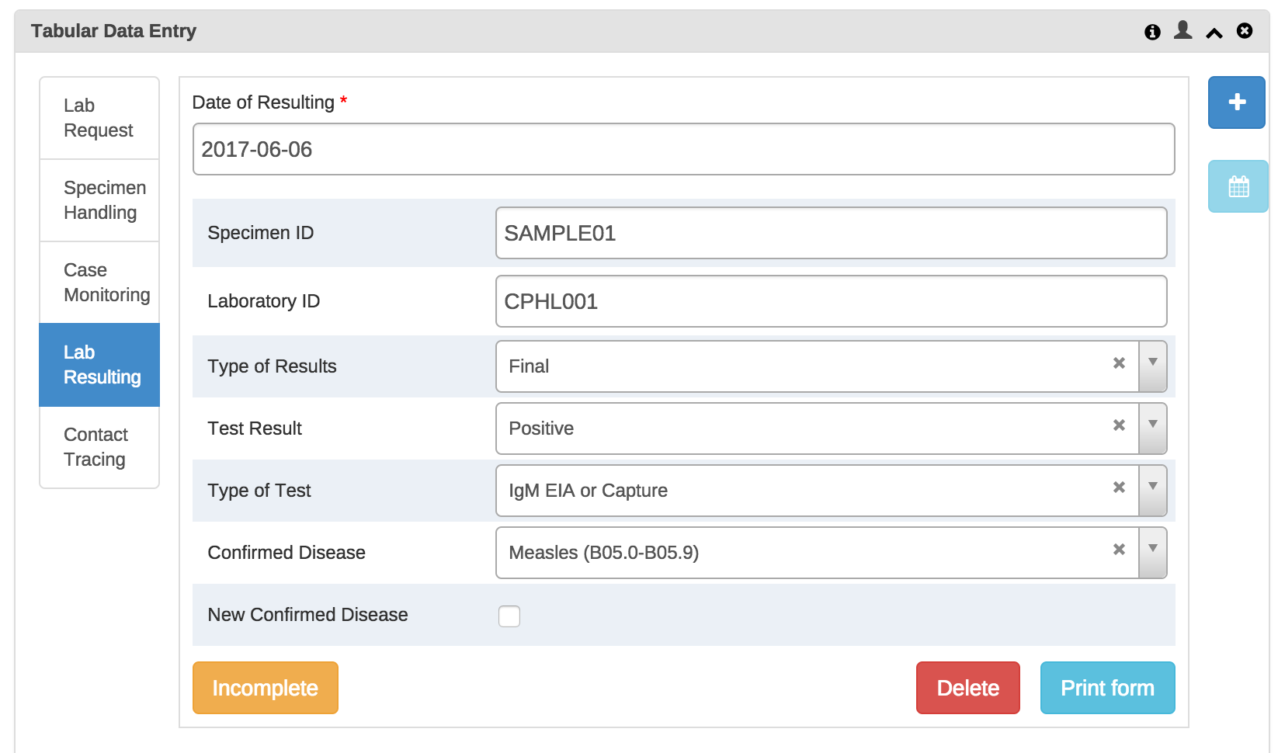
Specimen Receipt and Lab Results
Lab results for the suspected Measles
(B05.0-B05.0) case ID: 594915 from Atar HC II are ready check the IDSR/EOC system

Slide 12
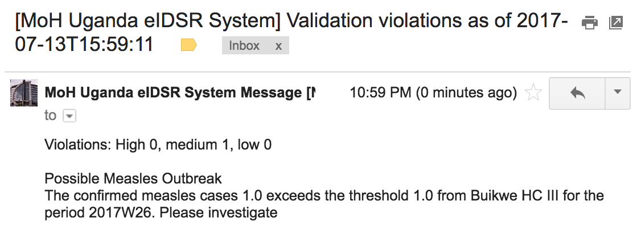
Possible Outbreak Alert
Possible Measles Outbreak
The confirmed measles cases 1.0 exceeds the threshold 1.0 from Buikwe HC III for the period 2017W26. Please inviestiage

Slide 13
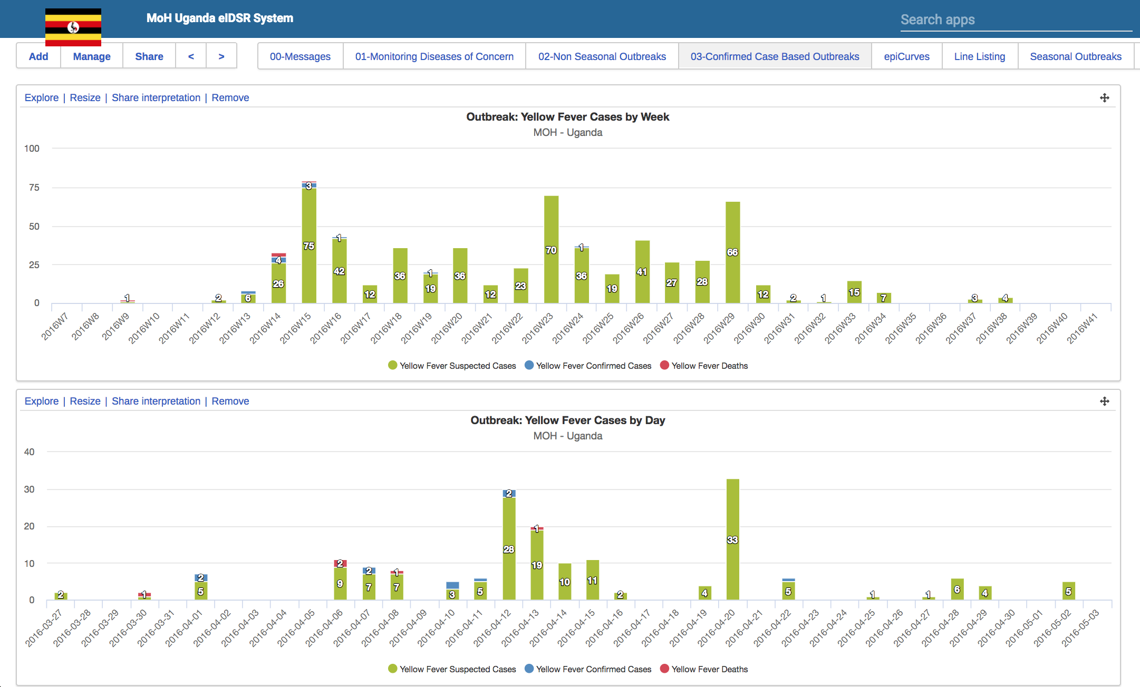
Epi-Curve Example of Yellow Fever 2016

Slide 14
eIDSR Previous Land Marks
July 5, 2017: Introductory meeting to the eIDSR system with respective Health MDA technical personnel
July 13, 2017: Presentation of the updated eIDSR system including inputs and suggestions from the first meeting
August 4, 2017: Presented the updated eIDSR system to the National eHMIS TWG and approved for National Rollout

Slide 15
Planned Next Steps and Roll out
System Stress testing: Entering Legacy data
Currently being undertaken by HISP-U. Yellow Fever complete
Planned field-based simulation drill
Organize a one week mock exercise to test system capabilities
Fix any identified bugs
ToT at National Level
Conduct a two days ToT of MoH and partners to equip them with skills to conduct regional training and support of end users
Conduct regional trainings of DHOs, DSFPs, DLFPs, Biostatisticians and other DHT members
Continuous monitoring of system use and support

Slide 16
Health Information Systems Program - Uganda
P.O. Box 4750, Kampala Plot 36 Impala Avenue, Kololo Tel:+256752751022 Email: hispug@hispuganda.org Website: www.hispuganda.org

